Slide 1
Chatbot Masterclass
By Douglas Tan
Student ID: p7397372
Email : TAN_JOO_SAY01.pt@ichat.sp.edu.sg

Slide 2
Business Case for 天天来炒虾面 (come daily Fried Hokkien Mee)
Why are you building chatbot? | How is it going to interact? | How can you build a conversation flow? | How are you going to get people to use? | How are you going to make money?
Increase sales by reaching customers from other parts of Singapore | Target customer: >= 13yo | Control the flow by providing menu to choose from | Publish chatbot on FB Messenger & Websites | Inform diners that website and FB Messenger can also order
Branding | Informal & friendly tone | Only 3 sizes – Small, Medium and Small Only 3 option – No chilli, chilli and extra chilli | Redirection from 3rd parties website such as Food Gourmet, Tourism promotion, Hotel, Airlines, etc | Increase online delivery sales
Digital presence | Simple and straight-forward order taking menu | Delivery or self collect | Viral marketing through fans and food lovers | Convenient and far reaching
Online order shorten queue.

Slide 3
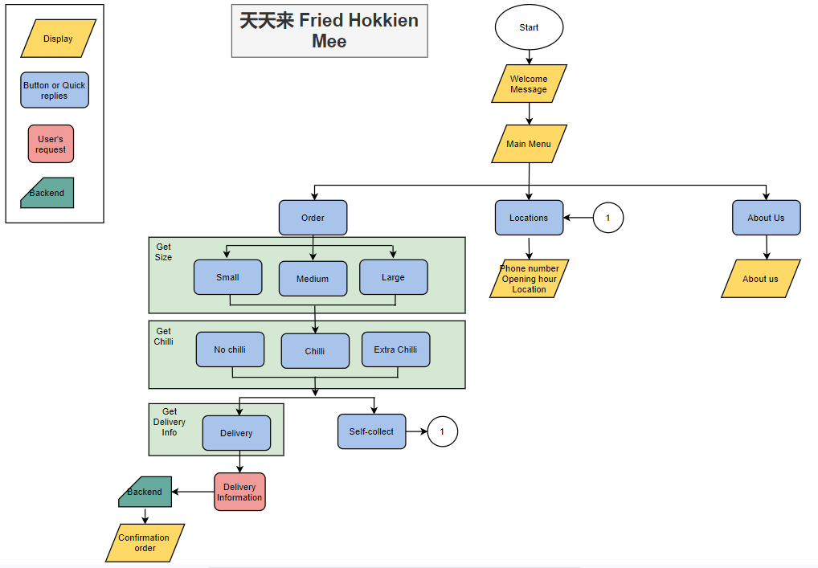

Slide 4
天天来炒虾面 (come daily Fried Hokkien Mee)
Hi
Click Order Now
Out: Session-vars = 50
Out: awaiting_Name = 1
Name
Back to Menu
1
Default Welcome
retrieve
Name
Phone
In : awaiting_Name
Out: awaiting_Phone = 1
Click Location
Click About Us
retrieve
Phone
Location
About Us
Size
In: awaiting_Phone
Out: awaiting_size = 1
Back to Menu
Small plate
Medium plate
Large plate
Back to Menu
retrieve
1
1
Chilli
In : awaiting_size
Out: awaiting_chilli = 1
No Chilli
Chilli
Extra Chilli
retrieve
Quantity
In : awaiting_chilli
Out: awaiting_qty = 1
retrieve
Quantity
Delivery Method
In : awaiting_qty
Out: awaiting_method = 1
In : awaiting_method
Out: awaiting_address = 1
Home delivery
Self collect
retrieve
Click Home Delivery
Delivery Address
Click Self-collect
Display Order for confirmation
In : awaiting_method
Out: awaiting_confirm= 1
Delivery Address
retrieve
Display delivery address & order for confirmation
In : awaiting_confirm
(Webhook call enabled)
Self-Collect
In : awaiting_address
Out: awaiting_confirm= 1
Click Confirm
Click Cancel
Home Delivery
Click Confirm
Click Cancel
Legend
Intents
End
Contexts variables
In : awaiting_confirm
(Set this intent as end of conversation)

